Slide 1

ML AND ANN PROJECT
P Sai Manaswi 2010030325
S Siva Karthik Reddy 2010030329
E R Sumanth 2010030051
K Snehith 2010030341
Srikar Kanche 2010030474

Slide 2
Skin Diseases Classification

Slide 3
CONTENTS
INTRODUCTION
01
PROBLEM STATEMENT
02
IMPLEMENTATION STEPS
03
GITHUB SETUP
05
OUTPUTS
04

Slide 4
INTRODUCTION
Image or Object Detection is a computer technology that processes the image and detects objects in it.
People often confuse Image Detection with Image Classification. Although the difference is rather clear.
If you need to classify image items, you use Classification. But if you just need to locate them, for example, find out the number of objects in the picture, you should use Image Detection.
Computer vision is a field of artificial intelligence (AI) that enables computers and systems to derive meaningful information from digital images, videos and other visual inputs — and take actions or make recommendations based on that information.
If AI enables computers to think, computer vision enables them to see, observe and understand

Slide 5
LITERATURE REVIEW
S.NO | Title | Author | Publication | URL
1 | Automating Skin Disease Diagnosis Using Image Classification | Damilola A. Okuboyejo, Oludayo O. Olugbara, and Solomon A. Odunaike | Proceedings of the World Congress on Engineering and Computer Science | Automating Skin Disease Diagnosis Using Image Classification
2 | A Benchmark for Automatic Visual Classification of Clinical Skin Disease Images | Xiaoxiao Sun, Jufeng Yang, Ming Sun, and Kai Wang | College of Computer and Control Engineering, Bankai University, Tianjin, China | https://link.springer.com/content/pdf/10.1007/978-3-319-46466-4_13.pdf
3 | Studies on Different CNN Algorithms for Face Skin Disease Classification Based on Clinical Images | Zhe Wu,Shuang Zhao,Xiaoyu He,Xinyu Zhao,Kai Huang, Xian Wu ,Wei Fan,Fangfang Li,Mingliang Chen,Jie Li | IEEE | https://ieeexplore.ieee.org/abstract/document/8720210
4 | A machine learning model for skin disease classification using convolution neural network | Viswanatha Reddy Allugunti | ResearchGate | https://www.researchgate.net/profile/Viswanatha-Allugunti-2/publication/361228242_A_machine_learning_model_for_skin_disease_classification_using_convolution_neural_network/links/62a46284a3fe3e3df86dc1d0/A-machine-learning-model-for-skin-disease-classification-using-convolution-neural-network.pdf

Slide 6
PROBLEM STATEMENT
Skin diseases are the 4th common cause of skin burden worldwide.
Robust and Automated system have been developed to lessen this burden and to help the patients to conduct the early assessment of the skin lesion.
Mostly this system available in the literature only provide skin cancer classification. Treatments for skin are more effective and less disfiguring when found early and it is a challenging research due to similar characteristics of skin diseases.
In this project we attempt to detect skin diseases and classify them into acne, melanoma, Eczema, Seborrheic Keratoses, Tinea Ringworm, Bullous disease, Poison Ivy, Psoriasis, Vascular Tumors, etc.

Slide 7
IMPLEMENTATION STEPS
Step-1:
Download Dermnet Dataset from Kaggle
Step-2:
Data preprocessing the given data
Step-3:
Comparing the output data to real data (Classification).
Step-4:
Now we will validate our model with some random images

Slide 8
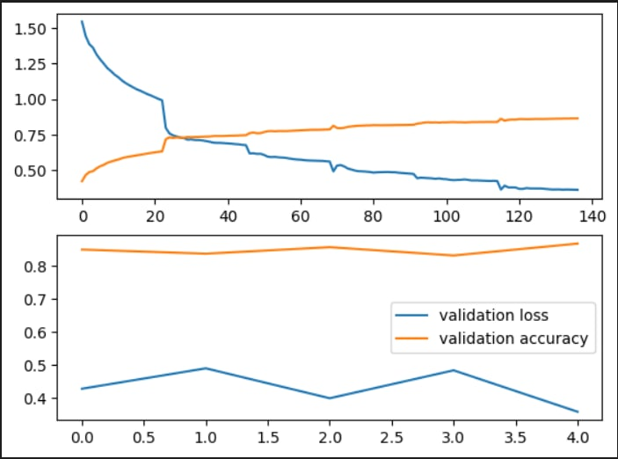
OUTPUT

Slide 9
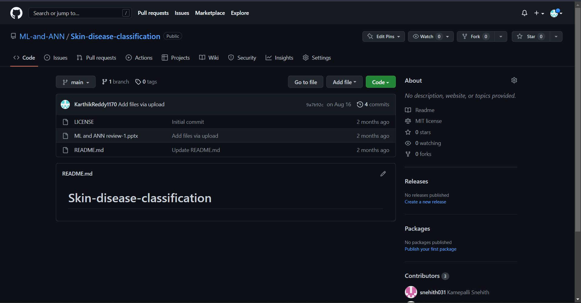
GIT HUB SETUP

